Slide 1

Student
Registration System
Presented by: Md Riyad Sarkar Course: Database System Design Date: 13/05/2026

Slide 2

Introduction
The Student Registration System is a web-based application used to manage student information digitally. It reduces paperwork, improves accuracy, and makes data management.

Slide 3

Objectives :
User-friendly system
Store data digitally
Reduce error
Easy access

Slide 4

Problem Statement:
Manual system are slow, error and inefficient.

Slide 5
Methodology:
Requirement Analysis
Frontend: HTML, CSS,JS
Backend: PHP
Database: MySQL
Testing & Deployment:
Deployment
System Design
Testing
Implementation

Slide 6
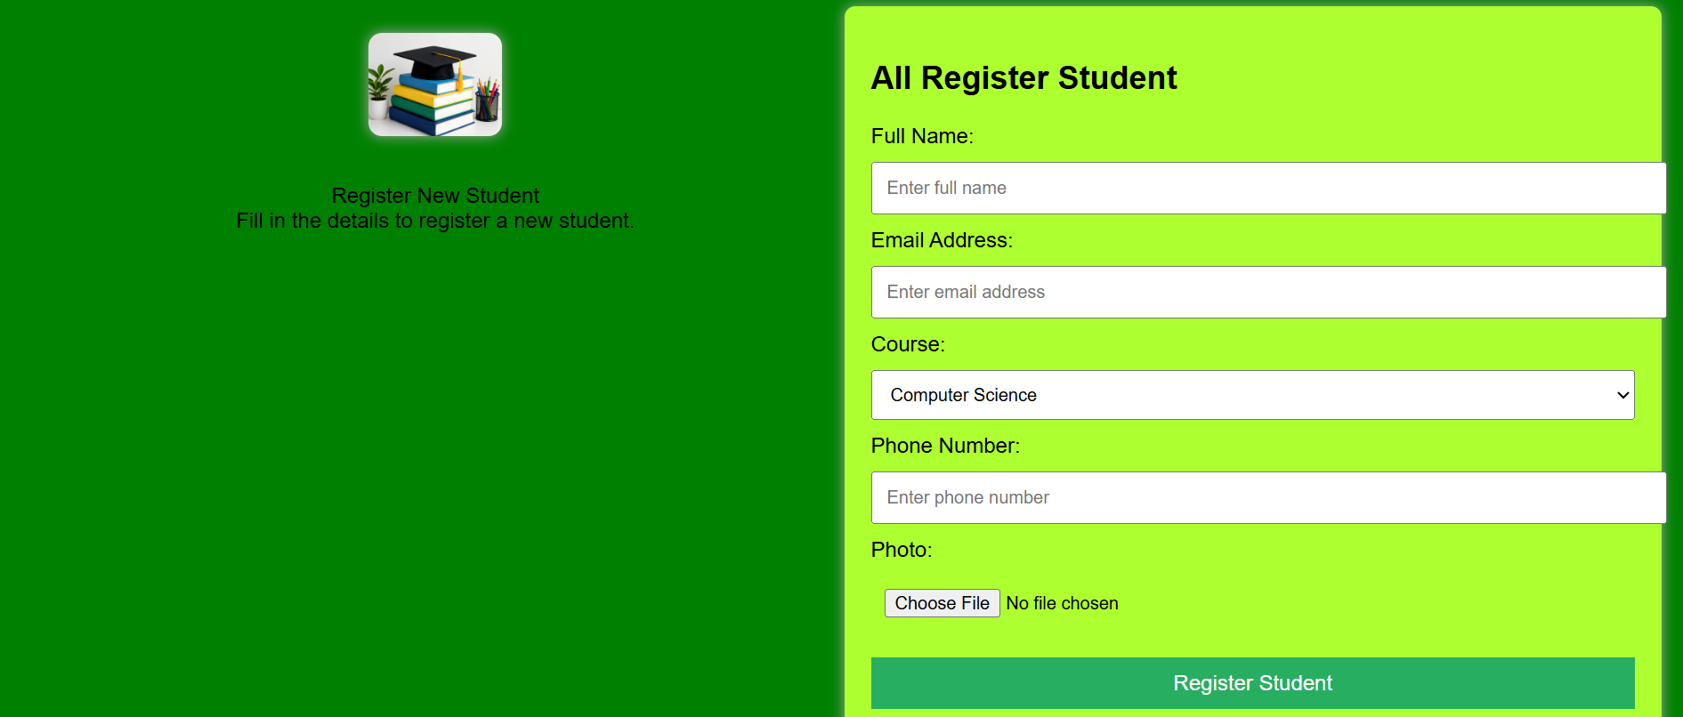
Database Design:
Table: Student

Slide 7

Features Improvements
Add Student Information
Update Student Data
Delete Records
Search Student Information

Slide 8
ER Diagram
Student-id
Full_name
Father Name
Email
Mother name
Student
Phone
Date-of Birth
Gender
Address

Slide 9
Requirements:
Hardware: Computer/Laptop
Software: XAMPP, VS Code, Browser

Slide 10
Conclusion
The Student Registration System is an effective solution for managing student
information digitally. It saves time, reduces paperwork, and improves accuracy
Thank You

